Slide 1
Phoenix School
E-learning website

Slide 2
Team Members:
Doaa Mohamed Mostafa
Nehal Abdellatif
Neama Ali

Slide 3
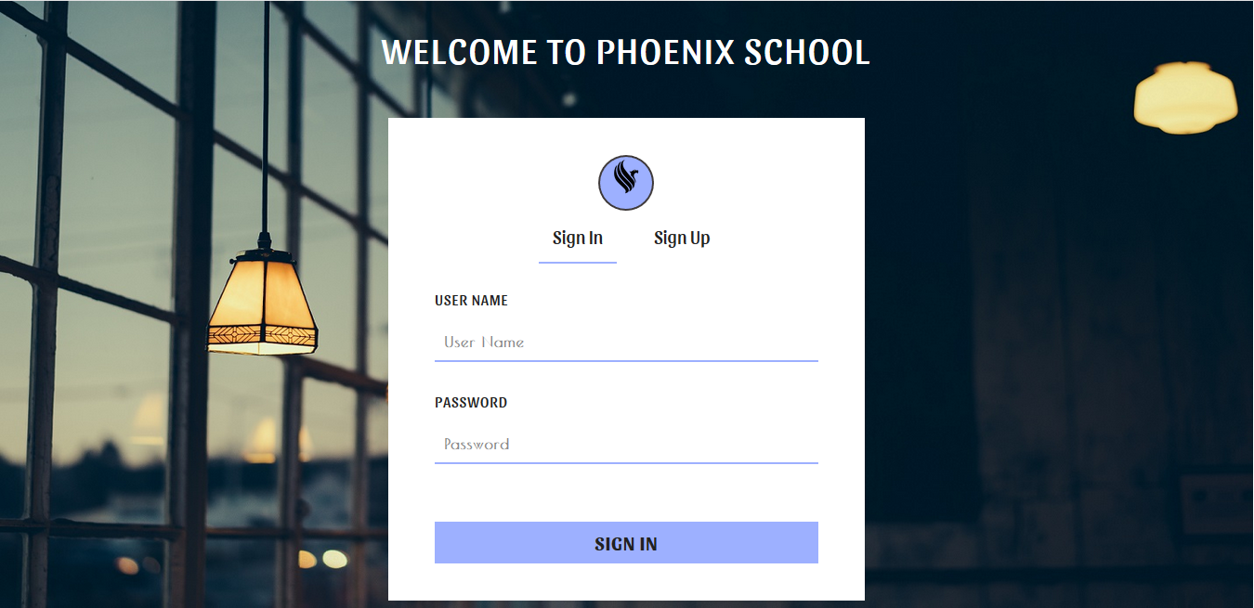
sign in

Slide 4
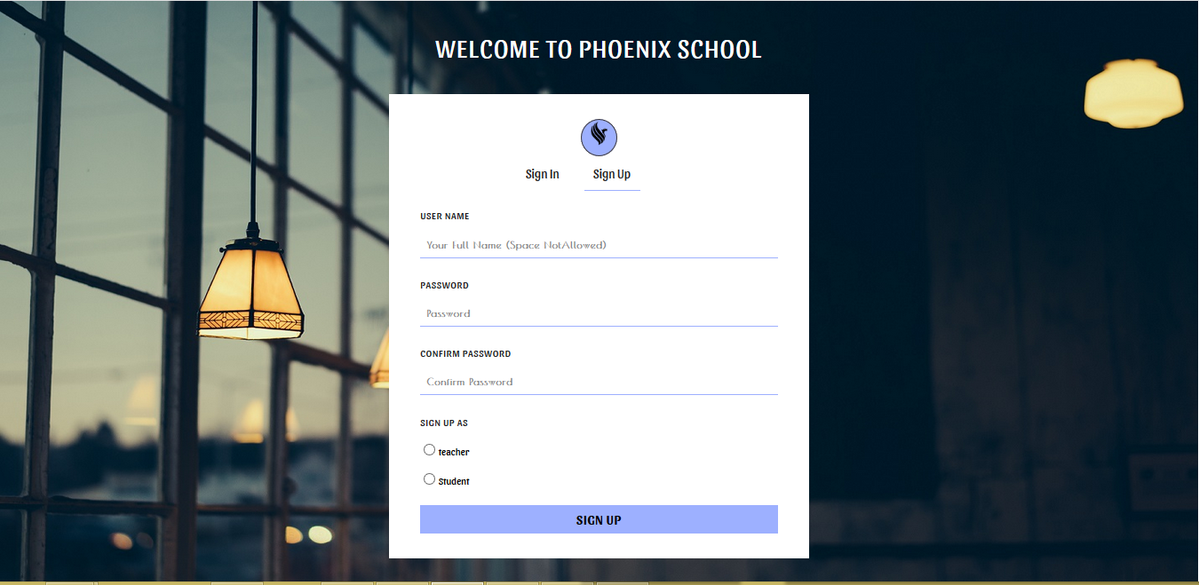
Or if you don’t have an account you can sign up

Slide 5
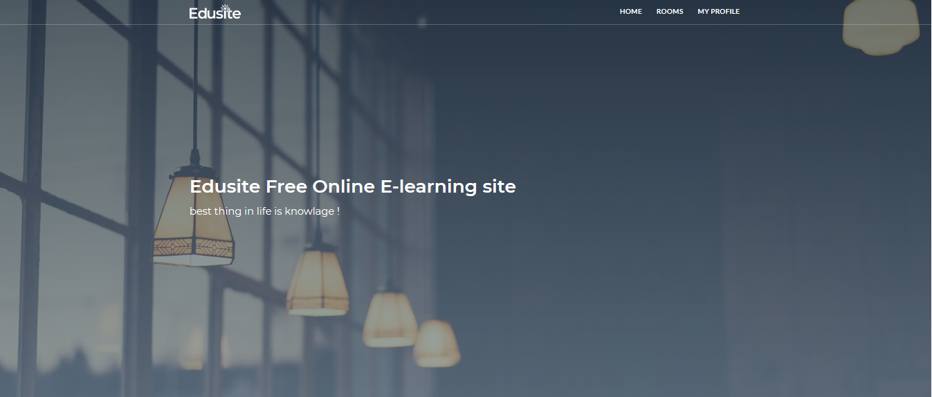
then you will find the home page

Slide 6
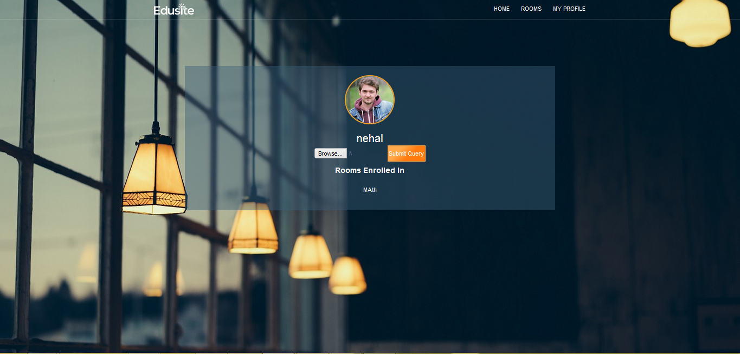
from home you can go to your profile

Slide 7
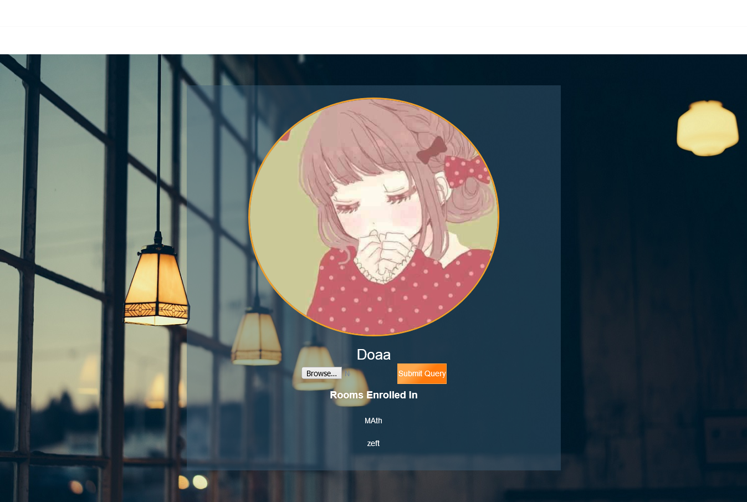
from your profile you can change your profile picture

Slide 8
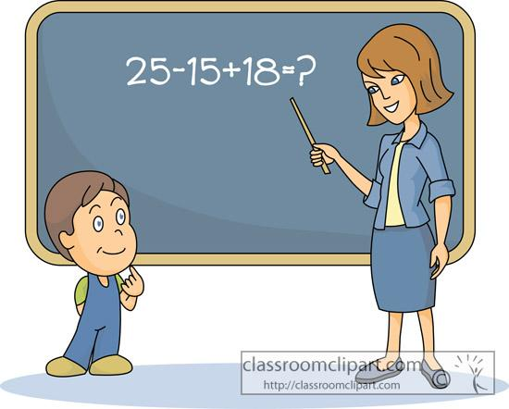
Teacher or Student !!

Slide 9
The teacher scenario
after login the teacher can go to the rooms where he can join a room or create a new one .
only teacher who can create a new room

Slide 10
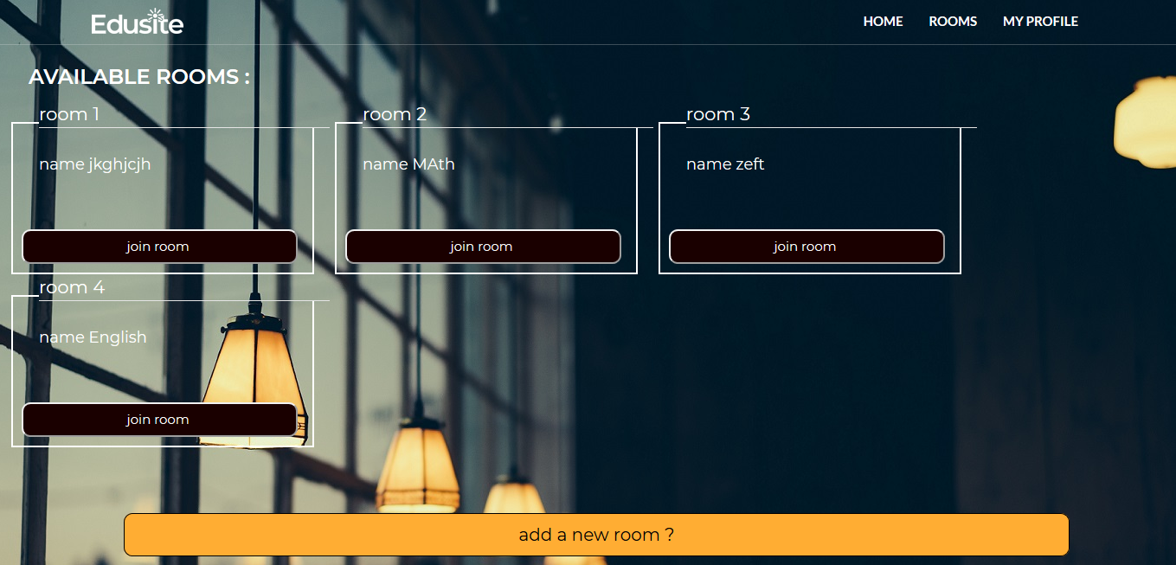

Slide 11
if the teacher join a room
if the teacher joined a room he will be able to draw on the board .
the student can’t draw on the board he only can watch what is on the board

Slide 12
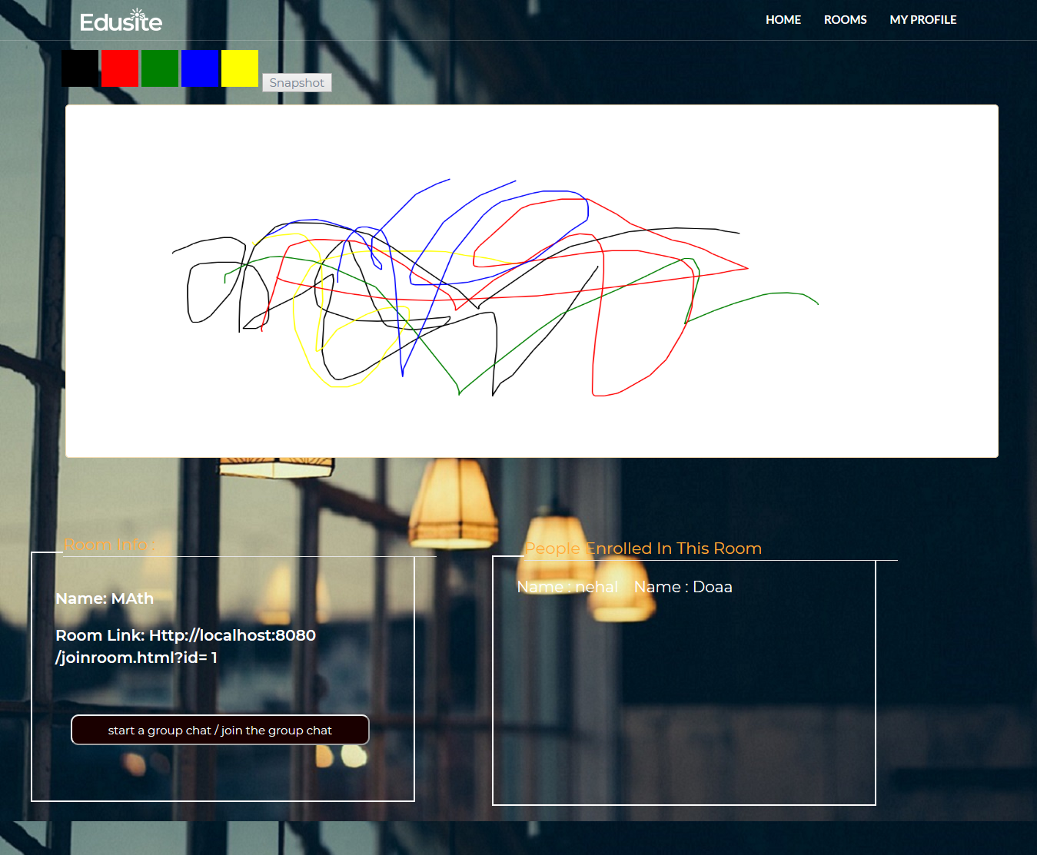

Slide 13
The student scenario
after login the student can see the rooms
and if he choose to join one he can watch what is drawn on the board.
every student has his own notebook
and can take screenshots

Slide 14
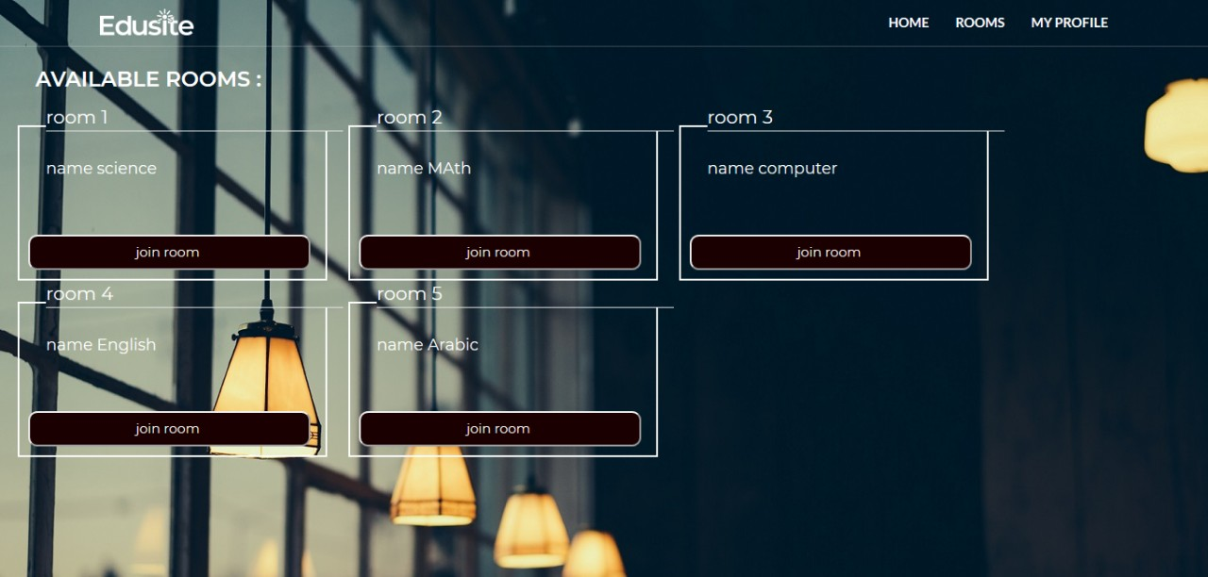
Student rooms page

Slide 15
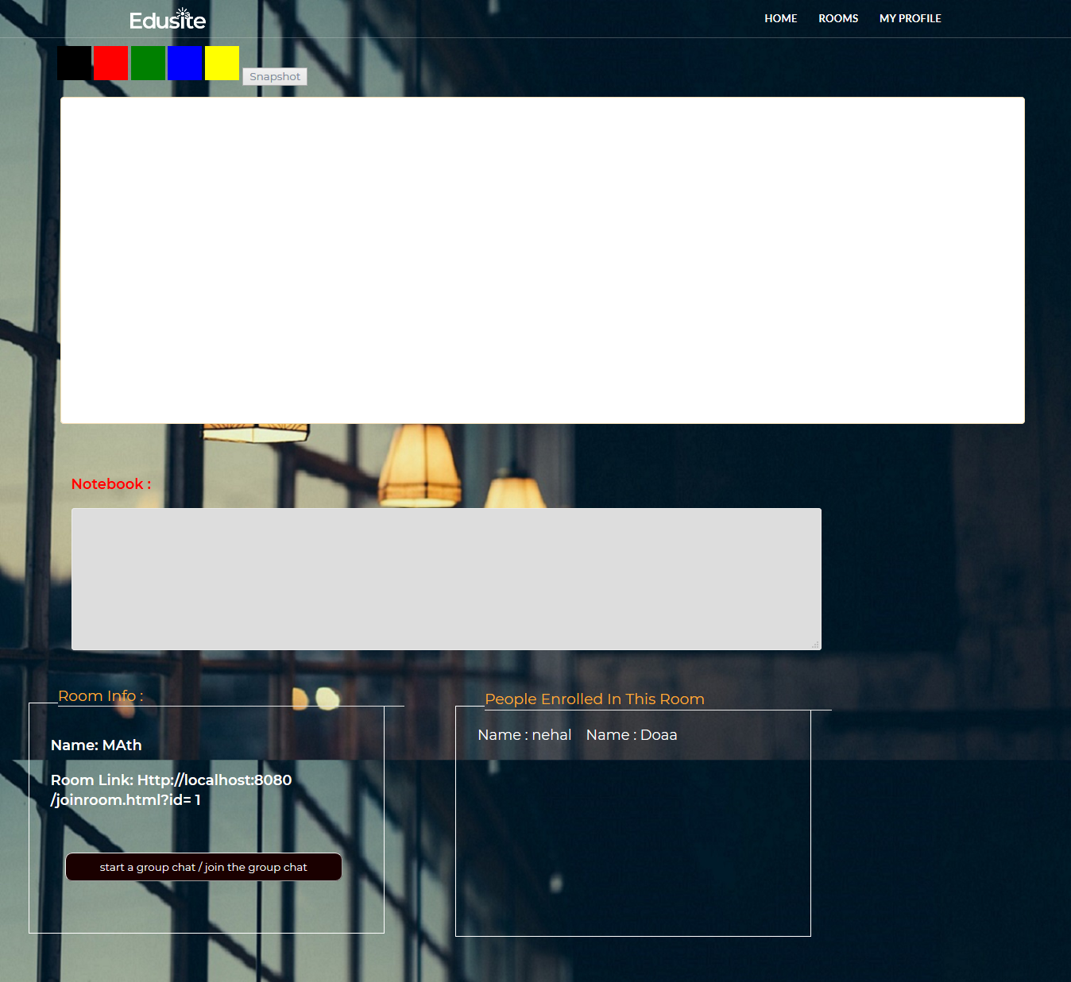
room page for student

Slide 16
everyone can chat
either you were student or teacher you can chat with your roommates and only them as you cannot chat with someone outside the room you are in

Slide 17
